Slide 1
Chiba Campaign Daily Report
2022 11/30
B3 Shunya Mizobuchi
Notes:
顧さんは？
1

Slide 2
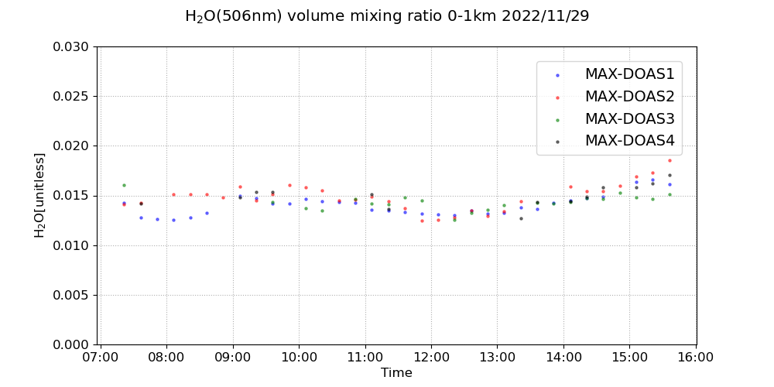
H₂O volume mixing ratio(4 Directions)

Slide 3
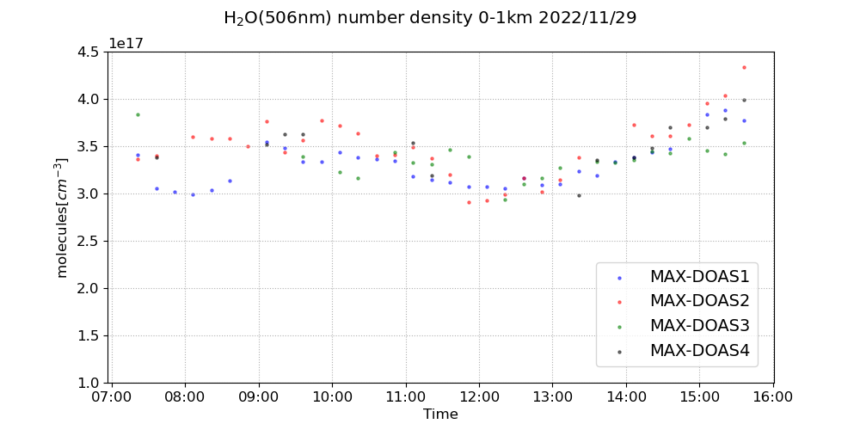
H₂O number density(4 Directions)

Slide 4
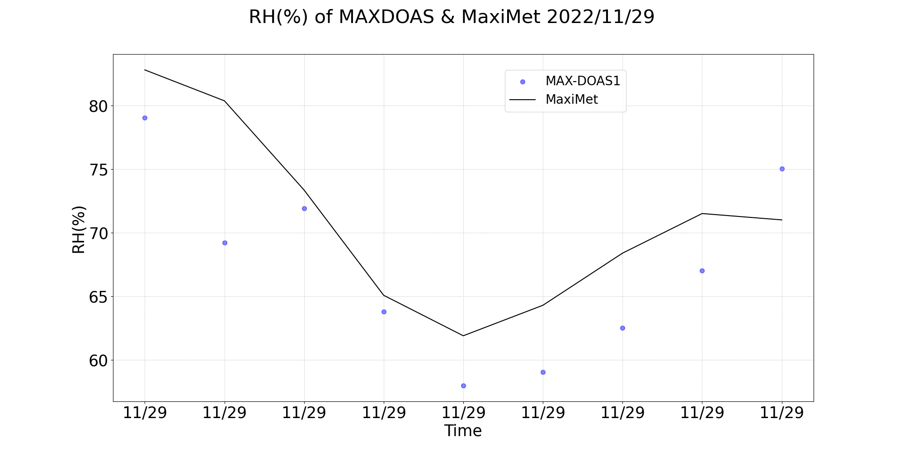
Comparison of RH between MAXDOAS and Maximet

